Slide 1
Medication errors within PV Centers
Pr. Rachida Soulaymani Bencheikh
Centre Anti Poison et de Pharmacovigilance du Maroc
WHO Collaborating Centre Rabat for Strengthening Pharmacovigilance Practices
Bogota, October 2019

Slide 2
Content
How important is the problem ?
What are the contributing factors ?
Why should PV centers be interested in ME ?
How to manage ME ?

Slide 3
Definition
Adverse Drug Reactions “ADRs”
“Noxious and unintended effect resulting not only from the authorized use of a medicinal product at normal doses, but also from medication errors and uses outside the terms of the marketing authorization, including the misuse and abuse of the medicinal product”
Directive 2010/84/EU of the European Parliament and of the Council

Slide 4
Definition
Medication Error
“An unintended failure in the treatment process that leads to, or has the potential to lead to harm to the patient”
Ferner & Aronson Lancet 2000: 355(9208): 947‐8
Preventable Adverse Drug Reaction
An injury that is the result of an error at any stage of the treatment process
Consensus during the Delphi survey

Slide 5
Magnitude of the problem
Adverse drug reactions are a reality
They have been well known for a long time now
Drugs carry a risk factor that can compromise individual of collective health

Slide 6
Why does harm happen ?
Drug is
Active substance
Substance foreign to the body
Irrational/Inappropriate use of drugs

Slide 7
Contributory Factors
Intrinsic activity
Quality
Patient
Health care Professionals
Risk Evaluation
Principal
effect
Raw materials
Socio-economic level
Education
Spontaneous reports
Preclinical and clinical trials and post marketing studies
Secondary
effect
Generics and biosimilars
Background
Implication
SMR
Marketing authorisation procedure
Countrefeit
substandard
Pharmaco -
épidémiology
Drug
Risk Factors
Workload
Adverse Event
Misuse
Organization
Previous sensitization
Conventional circuit
Pharmaco-dependance
Transparency
Therapeutic protocols
Information,
communication
Decison making
Allergen properties
Hors Circuit conventionnel
Ovedose
Medication error
Strategy
Media coverage
Risk management plan
Immunological effect
Distribution and storage
Ways of use
Health system
Risk Management

Slide 8
Widening scope of Pharmacovigilance
`
Shift in focus
From drug safety to patient safety

Slide 9
Since 1963 Pharmacovigilance scope has widened
From ADR related to medicines in normal use
To A Variety of ADR situations related to multiple Health Products
Creation of multiple Vigilance systems, under multiple structures

Slide 10
Pharmacovigilance
Medicinal products
Medicines, vaccines and combined oral contraceptives
Diagnostic radiology products
Biological products
Medical devices
Dietary products and food additives
Herbals
Homeopathic products
Cosmetics products
Veterinary products
Context/Circumstances
Normal conditions of use
Medication errors
Treatment failure
Drug-drug interactions
Pregnancy and lactation
Dependance
Resistance
Abuse, misuse
Intoxications
Toxicomany
Defective products or counterfeit products
Period
Clinical trials
Post Marketing
Statut
Legal circuit
Illegal circuit

Slide 11
Duplicating systems lead to
Staff and budget consuming
Divergence of terms and definitions
Conception and production of multiple reporting forms
Development of variety of methods for the same purposes
causality assessment
preventability methods
root cause analysis…
specific databases where cross analysis is not always possible
Confusion for reporters
Lack of coordination
Risks of overlaps and redundancies
Lack of cross-learning between systems

Slide 12
Organizations with related terms and definitions on their website
Adverse Drug Reaction Advisory Committee (ADRAC):Australia
N Agency for Healthcare Research and Quality (AHRQ): US
N American Society of Consultant Pharmacists (ASCP): USA
N American Society of Healthcare Risk Management (ASHRM):USA
N American Society of Health-system Pharmacists (ASHP):USA
N Association of Perioperative Registered Nurses (AORN):USA
N Australian Capital Territory Health (ACT Health): Australia
N Australian Council for Safety and Quality in Health Care
(ACSQHC): Australia
N Australian Patient Safety Foundation (APSF): Australia
N British Medical Association (BMA): UK
N Canadian Institute for Health Information (CIHI): Canada
N Commission for Healthcare Improvement (CHI): UK
N Commonwealth Department of Health and Aging:Australia
N ECRI (formerly the Emergency Care Research Institute):USA
Food and Drug Administration (FDA): USA
N Health Canada: Canada
160 Organizations
N Institute for Healthcare Improvement (IHI): USA
N Institute for Safe Medication Practices (ISMP): USA
N Institute of Medicine (IOM): USA
N Joint Commission on Accreditation of Healthcare
Organisations (JCAHO): USA
N National Academy for State Health Policy (NASHP): USA
N National Association of Public Hospitals and Health
Systems (NAPH): USA
N National Center for Patient Safety (NCPS): USA
N National Committee for Quality Assurance (NCQA): USA
N National Coordinating Council for Medication Error
Reporting and Prevention (NCCMERP): USA
N National Patient Safety Agency (NPSA): UK
N New South Wales Therapeutic Advisory Group (NSW
TAG): Australia
N Northern Sydney Health (NSH): Australia
N Quality Interagency Coordination Task Force (QuIC): US
N The Royal College of Physicians and Surgeons of Canada
(RCPSC): Canada
N United Kingdom Department of Health: UK
N Victorian Drug Usage and Advisory Committee (VDUAC):
Australia
World Health Organisation (WHO): International

Slide 13
Number of terms and corresponding definitions
Terms | Number of definitions (total)
Adverse drug event Adverse drug reaction Adverse effect Adverse event Adverse incident Adverse medication event Adverse reaction Critical event Critical incident Error Incident Medical error Medication error | 10 11 1 21 2 1 3 1 1 13 8 3 7
Terms | Number of definitions (total)
Medication incident Near miss Potential adverse drug event Potential adverse event Potential error Preventable adverse drug event Preventable adverse event Sentinel event Serious adverse event Side effect Significant adverse event Unpreventable adverse event | 1 8 4 1 3 2 2 5 2 6 1 2
Total of 119 definitions for 25 terms
:

Slide 14
A global system : Advantages
Sharing tasks and tools ➔ reduce human and financial needs
One stop shop for the reporter ➔ reduce problem of underreporting
Global database ➔ earlier detection of signals to risk minimization
Sharing expertise and cross learning

Slide 15
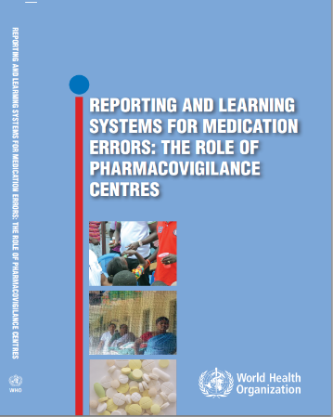
WHO Guideline
Objectives
Increase the capacity of national PVC to identify and analyse preventable ME
Stimulate cooperation between national PVC and the World Alliance for Patient Safety
Guidelines intended for
Pharmacovigilance Centres
Medication Safety Organizations
Patient Safety Organizations
Health professonals

Slide 16
Increase the capacity of national PVC to identify and analyse preventable ME
Collect and Identify preventable Adverse Drug Reactions (ADRs) and medication errors(ME)
Analyze preventable ADRs and ME reports
Put in place actions to minimize the risk of occurrence of preventable ADRs and ME

Slide 17
Pharmacovigilance Process
Data Collection
Case Validation and Analysis
Building up Database
Detection and Signal Validation
Root Cause Analysis and RMA

Slide 18
Collect and Identify preventable ADRs and ME
Integrated vigilances
Common Terminologies - taxonomies - procedures
Common reporting form
An integrated information system
Tools for Data Management
Training and capacity building

Slide 19
Standard reporting form Needs 5 Blocks
Patient (report Id)
AE/Incident
Reporter (to have more information)
Medicinal product: suspected and concomittent
Context /circumstances

Slide 20
Variable Data (1)
Health Products
Medicines, vaccines and combined oral contraceptives
Diagnostic radiology products
Biological products
Medical devices
Dietary products and food additives
Herbals
Homeopathic products
Cosmetics products
Veterinary products
Common Items
Name: Brand name and INN
Indication/ reason for use
Dose - Route
Duration : Start and stop date
Action taken

Slide 21
Variable Data (2)
Context /circumstances
Normal conditions of use
Medication errors
Treatment failure
Drug-drug interactions
Dependence
Resistance
Abuse, misuse
Poisoning
Toxicomany
Defective products or counterfeit products

Slide 22
Going beyond classic PV
PV centres need to adapt classic PV tools and methods to manage ME within PV centres
Expand the role of PV centres to the detection and the management of ME
Needs to develop new tools for analyzing
Preventability method:
ME classification,
Root Cause Analysis

Slide 23
Preventability Assessement
Preventability
Preventability implies that methods for averting a given injury are known and that an adverse event, results from failure to apply that knowledge
Leape, 1993
Preventable
What can be avoided by the implementation of appropriate measures
Preventable Adverse Drug Reaction
An injury that is the result of an error at any stage of the treatment process

Slide 24
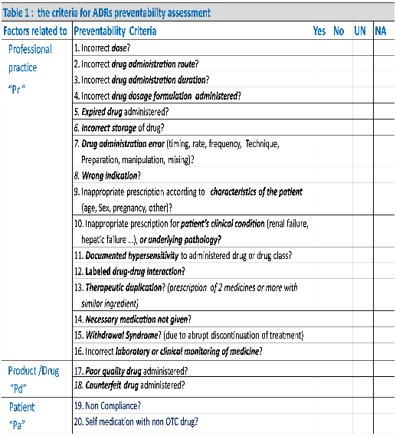
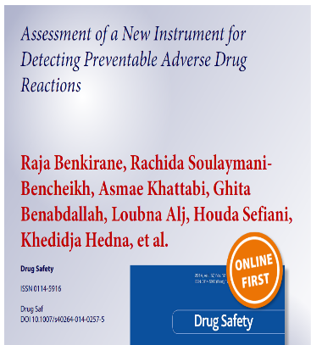
Preventability Assessement Tool to detect pADRS: The P Method
Notes:
In order to assess the preventability of an ADR easily, the P Method has been developed by the Moroccan PV centre team and validated by ten countries.

Slide 25
Preventability Method The P Method
Preventability Method concept
Allows systematic detection of ME and any irrational use of drugs, within ADRs reported to PVCs
Based on the identification of any well known preventable risk factors that increases the likelihood of ADRs occurrence : 20 defined preventability criteria.
Risk factors are related to
HCP Practices
Patient behavior
Product quality
Result of the method assessment:
Preventable: at least one preventability criteria is identified
Non preventable: none of the preventability criteria is identified
Not assessable: there is insufficient data for preventability assessment
Notes:
The P Method allows a systematic detection of ME within ADRs. Need to perfectly know the ADR. Maitriser l’effet indesirable
The method is based on 20 defined preventability criteria which are divided on 3 groups of risk factors related to HCP Practices, patient and Product
This assessment allows to classify ADRs as preventable, non preventable and not assessable

Slide 26
Preventable and Non Preventable ADR NOT FROZEN Statement
Closely linked to how drug is used and monitored
Depends on:
Time, space
Current state of knowledge on mechanism of ADR occurrence
Capacity of health services in developing therapeutic protocols and making tools and analysis for reducing the occurrence of ADR
Then, a Non preventable ADR may, in future, become a preventable ADR
Non preventable ADR in a country may be stated as a preventable ADR in another one

Slide 27
Role of Pharmacovigilance centres
PVC’s are in the heart of clinical practice, Public Health and Patient Safety Promotion
Adverse reaction are the entry point for PV practices
Capacity building of PV professionals should focus on how AR’s (risk for the patient and for the population) can be managed in order to:
To diagnose professionally the AE’s as a patient clinical state (risk identification)
To understand how and why it happened (risk management)
To anticipate de risk in order to avoid it occurrence (risk minimisation)

Slide 28
Pharmacovigilance towards maturity
50’s and 60’s: from nothing to reacting late
70’s: foundation of Pharmacovigilance principles
80’s to 90’s : From reacting late to reacting earlier
2000’s : Getting proactive and fast reacting toward risks

