Slide 1

GUIDELINES FOR THE CONDUCT OF DRUG RELATED CLINICAL TRIALS
SHEILA AMPAIRE
NATIONAL DRUG AUTHORITY
27th March 2019

Slide 2
Presentation Outline
Regulatory framework for the guidelines
Reasons for review of these guidelines
What is new in the guideline
Processes removed from the guideline
Conclusion

Slide 3

Regulatory FRAMEWORK
These guidelines are drawn under section 40 of the National Drug Policy and Authority Act
The National Drug Policy and Authority (Conduct of Clinical Trials) Regulations, 2014, Statutory Instrument No.32.

Slide 4
About this guideline
The current document is a revision of the Guideline for the Conduct of Clinical trials in Uganda, December 2007.
Update the processes communicated in line with the regulations.
Notes:
Several review meeting were held at NDA with input from other directorates, the NDA legal team and now we are bringing to our stakeholders to advise and for their input.

Slide 5

Reasons for revision of the guideline
Align the guideline to the National Drug Policy and Authority (Conduct of Clinical Trials) Regulations, 2014, Statutory Instrument No.32.
Remove obsolete procedures and information from the guideline
Clarify and elaborate guidance on application processes in different cases
Notes:
Whenever I mention a regulation it is in reference to the Conduct of Clinical Trials Statutory instrument

Slide 6
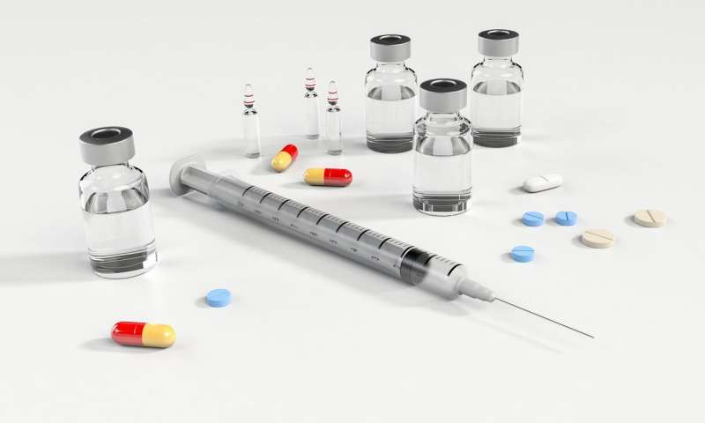
New in this guideline
Clarification of when to apply for a Clinical Trial certificate(regulation 3)
This section clearly details the different clinical studies that should apply for a Clinical Trial Certificate;
Investigate a new medicine or vaccine (including pharmacokinetic, bioequivalence and first-in-human studies) that has not yet received any marketing authorization anywhere in the world.

Slide 7
When to apply…(regulation 3)
Investigate registered medicines where the proposed use is outside the registered aspects of the medicine
Do comparative bioavailability trials
Generate information on the absorption, distribution, metabolism and excretion of one or more medicinal products;
Use an investigational medicinal product on human participants.
Studies using medical devices to deliver a drug or medicinal product to a human participant
Notes:
1. including; indication and clinical use of the medication, route of administration, target population, dosage and dosage form.

Slide 8
New in this guideline;
Studies that only require notification
There are some studies that require notification to the NDA although these wont require review and certification;
Clinical Trials for new Medical devices; However a synopsis of the study shall be submitted to the Authority for verification purposes.
Notes:
However a synopsis of the study shall be submitted to the Authority for verification purposes. There is no provision under the current Act or Regulations to authorize clinical trials involving investigational medical devices.

Slide 9
Studies that require notification
Socio-behavioural studies using registered drugs or medicinal products.
Studies where the objectives and end-points of the research are not about the drug product and the product has received marketing authorization in Uganda or a country with a stringent regulatory authority.
Notes:
SRAs according WHO 2016
• The European Commission, with EMA and including the individual member states
• the US Food and Drug Administration (US FDA) • the Pharmaceuticals and Medical Devices Agency of Japan • Health Canada • Swissmedic.

Slide 10

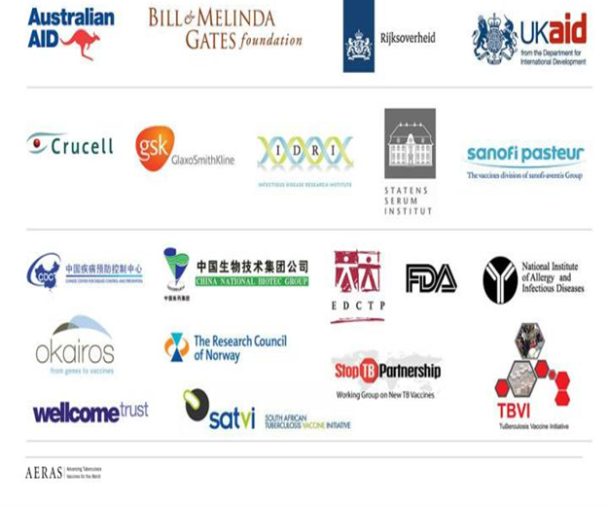
Who should apply;
Regulation
The Sponsor or Principal Investigator
Based on the Clinical Trial Agreement between the Sponsor and the Principal Investigator(PI), the Authority will liaise with the PI who is the representative of the sponsor in the country.
Notes:
The PI remails the applicant because the Ugandan laws apply to they and they can be prosecuted
The agreement between the sponsor and the investigator/institution is recommended by the ICH GCP section 5.9

Slide 11

Validation of completeness of the application
An application will be screened for completeness as per the requirements of the regulations
Incomplete applications will not be received by the NDA

Slide 12
Application package(Regulation 4&5)
CTA | Clinical Trial Application Form
APPENDIX 1: | Trial Protocol
APPENDIX 2: | Investigators Brochure
APPENDIX 3: | Participant Information Leaflet and Informed Consent
APPENDIX 4: | Certificate of GMP manufacture of the trial medicine or other evidence of manufacture quality, safety and consistency
APPENDIX 5: | Package Insert/s for other trial medicines.
APPENDIX 6: | Certificate of GMP manufacture of the placebo - if appropriate.
APPENDIX 7: | Evidence of accreditation of the designated Laboratories or other evidence of GLP and assay validation.

Slide 13
Application package;
APPENDIX 8: | Insurance Certificate specific for the trial in consultation with NDA
APPENDIX 9: | Signed and completed Declarations by all Investigators
APPENDIX 10: | UNCST or REC approval
APPENDIX 11: | Full, legible copies of key, peer-reviewed published articles supporting the application.
APPENDIX 12: | Sample of the label for the imported products
APPENDIX 13: | Letter of authorization from the manufacturer/product owner
APPENDIX 14: APPENDIX 15 APPENDIX 16 | Pharmaceutical Data on dosage form Duly signed declaration of the monitor Clinical trial agreement between the sponsor and the principal investigator

Slide 14
Clarified the types of review
1. Internal Review; These are reviews conducted by the NDA Secretariat shall be further subdivided into;
Expedited Reviews: These shall apply wherein a regulatory decision shall be given to the applicant within 30 working days or as will be determined by the Authority.
Routine Reviews; these reviews shall be conducted according to the current NDA service delivery timelines as published on the NDA website.

Slide 15

Criteria for expedited review
Clinical trial applications for IMPs to provide treatment where no alternative therapy exists according the the Uganda treatment guidelines.
Clinical trials conducted in an emergency for example during a disease outbreak.
Clinical trial applications that do not explicitly meet the above criteria and are led by the Ministry of Health in the interest of a public health intervention
The Secretariat reserves the right to determine which application may undergo this kind of review where the criteria may be unclear.

Slide 16
Types of review
2. Expert Review; the application may be reviewed by external reviewers co-opted by NDA following internal procedures.
3. Joint Reviews; These reviews are carried out jointly with all the regulators that is the NDA, UNCST and the primary IRB/REC. These reviews are coordinated by the UNCST.

Slide 17

Important to note…
Reviews for clinical trials will be done following a first-in first-out principle
Service delivery timelines for different applications are published on the NDA website
A stop-clock mechanism shall therefore apply each time the Authority requests for additional information.
Notes:
These timelines shall not include the time taken by the applicant to respond to any requests for additional information from the Authority. A stop-clock mechanism shall thus apply each time the Authority requests for additional information.

Slide 18

Regulatory decision
Regulation 6
There will be three outcomes from the review of the application submitted;
1. Authorization of the clinical trial and subsequent award of the Clinical Trial Certificate(CTC);
2. Request for additional information to support the application.
3. Rejection of the clinical trial application with reasons

Slide 19
Approval by the UNCST
UNCST approval is a regulatory requirement for all scientific research and is required prior to application for a Clinical trial Certificate
For studies authorized by an institution other than UNCST, NDA will withdraw from review applications that are not given a favourable opinion by the UNCST.

Slide 20
Post Authorization procedures
Annual Renewal of authorization to conduct clinical studies
Signed Cover letter clearly indicating protocol title
Valid ethical approval of the study
Annual progress report clearly indicating reporting period
DSMB report /Line listing of SAEs during the reporting period
Investigational Product Accountability for the reporting period and projected need for the next period

Slide 21
Amendments
Regulation 10 of the National Drug Policy and Authority (Conduct of Clinical Trials) Regulations, 2014 the applicant shall apply to deviate from the conditions of the clinical trial certificate as an amendment application
Appendix 5 of the guideline(page 61) details all the amendments that require NDA authorization

Slide 22
CTA Amendments
Clarified that differs Supporting documents required for amendments that require NDA authorization.
Signed Cover letter summarizing proposed amendment
Completed amendment form (Form 36)
Submission of Protocol Amendment in tracked changes and clean copy clearly indicating protocol version number
Valid evidence of payment of amendment fees
Ethical approval of proposed amendment

Slide 23
Reports
Safety reports: This section clarifies reporting requirements for Serious Adverse events (SAEs) and Suspected unexpected Serious Adverse Reactions(SUSARs) arising out of clinical trials and the applicable timelines.
Trial Progress Reports
End of study reports

Slide 24

Maintenance of records
Documents may be stored in electronic (soft and scanned) or hard copies.
The holder of the clinical trial certificate/applicant should inform NDA in writing prior to destroying the documents. Documents shall be retained for a minimum period of 20 years in line with the above regulation.

Slide 25

Inspections
Pre-and post authorization inspections will be carried out to;
To assess the staff and facilities to be used or that are being used for the conduct of the clinical trial,
To verify the availability of the necessary resources and feasibility of conducting the study at the proposed site(s).
Compliance with CTC conditions and GCP

Slide 26



The Investigational Medicinal product
Importation
Manufacture
Labelling of the Investigational Medicinal Product (IMP)
Responsibilities of the Sponsor, Study PI and the trial Pharmacist
Non Investigational medicinal products
Post Trial Access of the IMP

Slide 27
Responsibilities
Sponsor
Ensure timely delivery of the investigational product(s) to the investigator(s);
Maintain a system for retrieving investigational product(s) (recall)
Maintain a system for the disposal of unused investigational product(s) and document the process.
Not supply or ship the investigational medicinal product until all the required documentation has been obtained.
ensure that the investigational product(s) (including active comparator(s) and placebo, if applicable) is characterized as appropriate to the stage of development of the product(s), is manufactured in accordance with any applicable GMP
Ensure that the investigational product(s) are stable over the period of use and avail stability records upon request.
Pharmacist of record
Maintain instructions for handling of the IMP
Application for importation(CoA, Labelling, GMP, BL,PFI, PL, Invoice )
Maintaining records(Shipping, accountability, dispensing, destruction)
Ensure appropriate storage conditions(temperature monitoring)
Documentation regarding allocation of treatment, randomization and code breaking.
Investigational Medicinal Product(s) accountability at site (pharmacy or investigator):
Date and quantity dispensed or returned, identification of recipients (patients code or authorised persons).

Slide 28
Removed from the guideline
Clarified expert review according to current procedures
Institutional Review Committee(IRC)
Information on Clinical Trial License
Clinical Trial Committee
30 days review timeline

Slide 29
Obligations
Any person who knowingly supplies any false or misleading information in connection with his application for Clinical Trial Certificate commits an offence under section 60 of the National Drug Policy and Authority Act.
Other applicable laws shall be adhered to even when NDA has provided approval(Privacy and Confidentiality act of 2019, Narcotics Laws)

Slide 30
Thank you!

Slide 31

Any questions???

Slide 32
References
The National Drug Policy and Authority Act, CAP 206, section 40
The National Drug Policy and Authority (Conduct of Clinical Trials) Regulations, 2014, Statutory Instrument No.32.
ICH GCP Guidelines E6 R2

